Slide 1
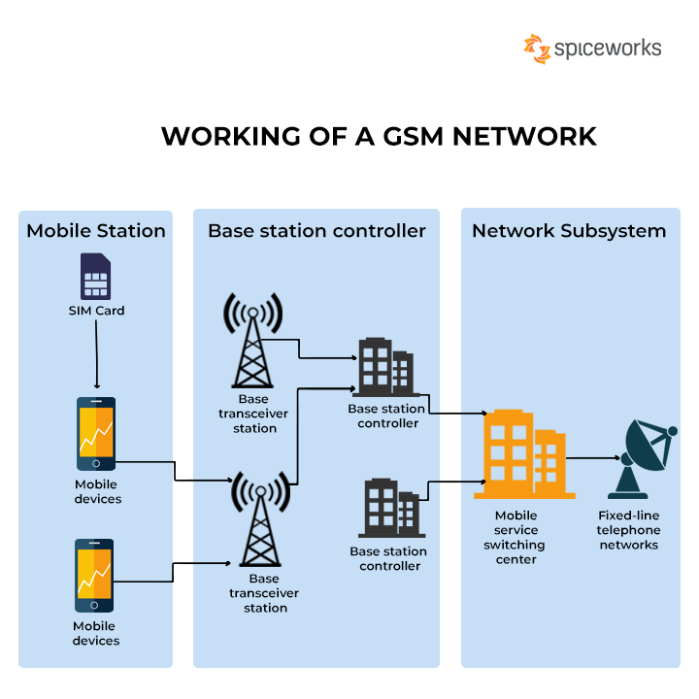
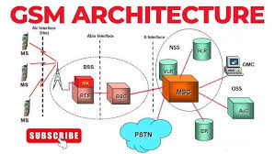
Department of Electronics Engineering
TAE-1
SUBJECT: DIGITAL COMMUNICATION
TOPIC : GSM(Global System for Mobile Commuication)
GSM (Global System for Mobile Communications) is a set of mobile communications standards and protocols governing second-generation or 2G networks, first developed and deployed in Europe. The Working of a GSM Network. GSM is a digital cellular communication standard that is universally accelerated.
WORKING:
While using the 900 MHz bandwidth was one of the initial plans for the Global System.
The GSM frequency bandwidths are generally separated into two paths: 900/1800 MHz and 850/1900 MHz
A GSM network has five cell sizes: macro, micro, pico , and umbrella. Depending on the option provided, the connectivity of each cell differs.
USES:
International roaming
Low-cost mobile stations
High quality speech
Improved spectrum efficiency
Short message service (sms)
Security
TYPES OF GSM:
The GSM network is divided into three major systems:
The switching system (SS)
The base station system (BSS)
The operation and support system (OSS)
Submitted to: Rucha Jichkar
Presented by : Raksha Ghotekar-12

Slide 2
TYPES OF GSM:
The GSM network is divided into three major systems:
The switching system (SS)
The base station system (BSS)
The operation and support system (OSS)

